Slide 1
EMAIL SPAM DETECTION
SudhaRani.R

Slide 2
AGENDA
Introduction
Problem Definition
Proposed Methods
Description of Database
Description of Proposed Models
Result

Slide 3

Spam Detection
non
spam
spam

Slide 4
Abstract
Machine learning is a branch of artificial intelligence concerned with the creation and study of systems that can learn from data. A machine learning system could be trained to distinguish between spam and non-spam (ham) emails. We aim to analyse current methods in machine learning to identify the best techniques to use in content-based spam filtering.

Slide 5
Data Description
48 continuous real [0,100] attributes of type word_freq_WORD .
6 continuous real [0,100] attributes of type char_freq_CHAR.
1 continuous real [1,...] attribute of type capital_run_length_average .
1 continuous integer [1,...] attribute of type capital_run_length_longest .
1 continuous integer [1,...] attribute of type capital_run_length_total .
1 nominal {0,1} class attribute of type spam

Slide 6
Learning Models
Simple logistic model.
Decision tree.
SVM.
Naïve Bayes
Random Forest

Slide 7
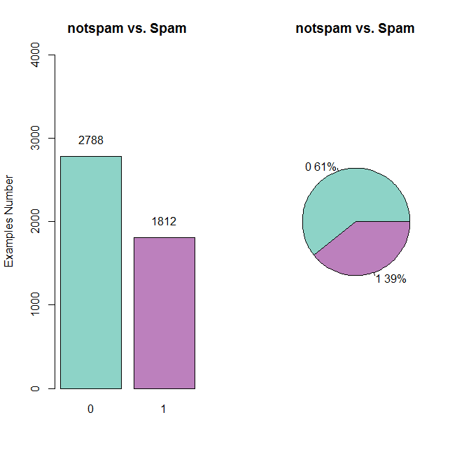
Numbers of not spam vs. Numbers of Spam in DataSet

Slide 8
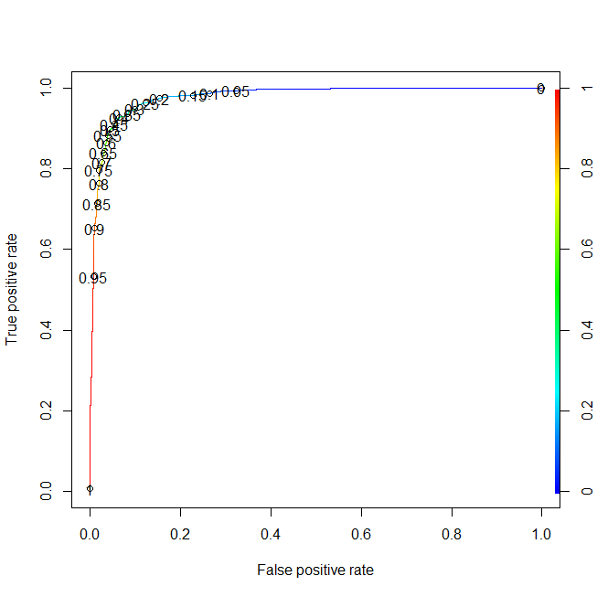
Outcomes of logistic model

Slide 9
Bayesian classification
Want
Use Bayes Rule:
Assume independence: probability of each word independent of others

Slide 10
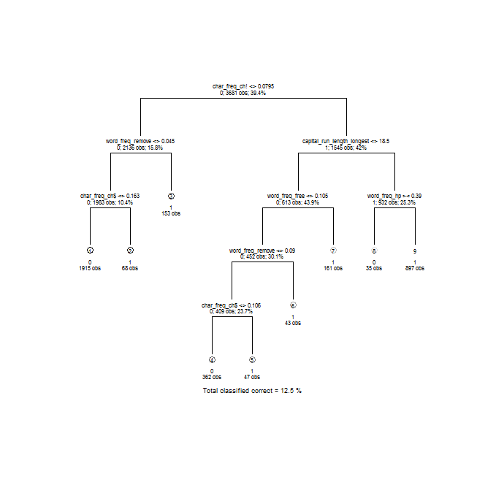
Outcome of decision Tree

Slide 11
Outcome of SVM Model
SVM-Type: C-classification
SVM-Kernel: linear
cost: 10
gamma: 10
Number of Support Vectors: 849
(424 425)
Number of Classes: 2
Levels:
0 1

Slide 12
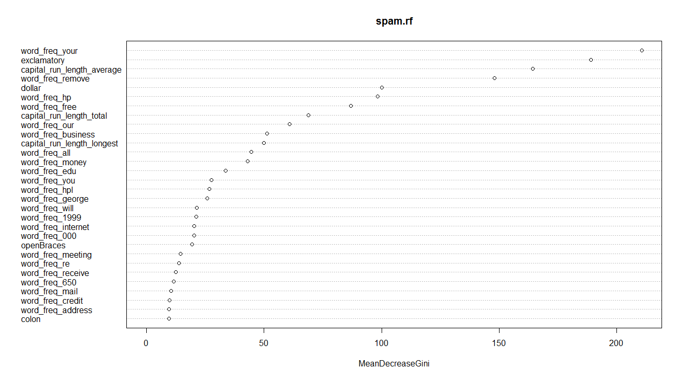
Outcome of Random Forest

Slide 13
Conclusion
Need to optimize on specificity(false positive as variable).
Because false negatives (spam goes to the inbox) are more acceptable than false positives (non-spam is caught by the spam filter)

Slide 14
FINAL RESULT
models | Accuracy | Specificity | Sensitivity
logistic | 0.9277 | 0.9292 | 0.9253
 | 0.9325 | 0.9350 | 0.9286
SVM | 0.9133 | 0.9516 | 0.8545
 | 0.914 | 0.9569 | 0.8481
Decision Tree | 0.8998 | 0.9355 | 0.8448
 | 0.9042 | 0.8564 | 0.9354
Naïve Bayes | 0.7101 | 0.5567 | 0.9462
 | 0.7116 | 0.5530 | 0.9558
Random Forest | 0.991 | 0.9969 | 0.9821
 | 0.9478 | 0.9731 | 0.9088

Slide 15
Conclusion
The Random Forest performs better than other classifiers with sensitivity, specificity and accuracy values 0.9088 , 0.9731 and 0.9478 respectively.

